Slide 1
Algorithms & DS
2D Arrays
S. Mulligan

Slide 2
2D Arrays
Last time we introduced 1D arrays.
Now we look at 2D arrays
2D two-dimensional arrays have rows and columns.
So we need row index = i, and column index j.
Array has N rows and M columns
Total of NM memory locations needed.

Slide 3
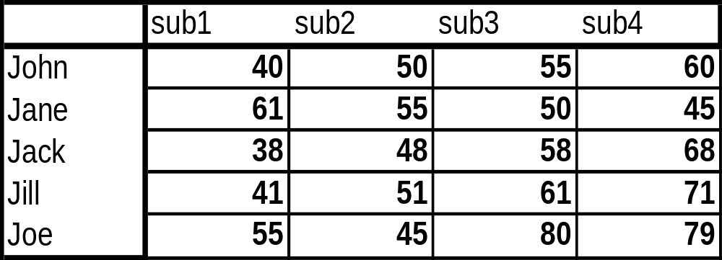
Arrays
A typical array e.g. marks(i, j) might look like:
Has 5 rows and 4 columns.
Each row represents marks for 1 student
Each column is marks for 1 subject.
Note array stores all integers. Same data type.

Slide 4
2D Arrays
Array operations.
Read numbers into the Array elements.
N := 5; // N rows
M := 4; // M columns
for i = 1, N
for j = 1, M
read marks(i,j)
end j
end i
This is a nested for loop (loop within another one)
Syntax in C is marks[i][j]

Slide 5
2D Arrays
To process all elements of a 2D array we need to loop over all the rows,(i index) and for each row, we must loop over each element in the row (j index)
So the pseudocode processes the elements row by row:
marks(1,1), marks(1,2),…,marks(1,M)
marks(2,1), marks(2,2),…,marks(2,M)
…..
marks(N,1), marks(N,2),…,marks(N,M)

Slide 6
2D Arrays
Each element has 2 indices:
marks(i, j) = element on row i, column j.
marks(1,1) = 40
marks(1,2) = 50
marks(1,3) = 55
marks(1,4) = 60, marks(5,4)=79, etc
Typical computations.
Sum elements of a row (student average)
Sum elements of a column (subject average)

Slide 7
2D Arrays
How do we sum the first row. Same as for a 1D array. Row index = 1, fixed.
i :=1
sum1 := 0 // initialisation.
for j = 1, M
sum1 := sum1 + marks(i, j)
end for
Sum of the second row.
i :=2
sum2 := 0 // initialisation.
for j = 1, M
sum2 := sum2 + marks(i, j)
end for

Slide 8
2D arrays
How do we sum the first column. Same as for a 1D array. Column index = 1, fixed.
j := 1
sum1 := 0 // initialisation.
for i = 1, N
sum1 := sum1 + marks(i, j) // could use marks(i,1)
end for
Sum of the second column.
j := 2
sum2 := 0 // initialisation.
for i = 1, N
sum2 := sum2 + marks(i, j) // could use marks(i,2)
end for

Slide 9
2D arrays
Manipulating rows/columns.
If the row index is fixed, then we go across elements of a row.
If the column index is fixed, then we go down elements of a column.
In Maths/physics:
  1D array is a vector.
  2D array is a matrix.
Many important applications in science/engineering, e.g. geometry, mechanics, computer graphics/games.

Slide 10
2D arrays
Arrays may also store character data, not only numbers. So we could have 2 1D arrays for the Name(N) and subjects(M).
Example:
Name(1) := “John”
Name(2) := “Jane”,…,Name(5) := “Joe”
In C syntax we would have:
subject[1] = “Algorithms”
subject[2] = “Programming”
subject[3] = “Maths”
subject[4] = “Databases”

Slide 11
2D arrays
So row i matches Name(i), i = 1,…,N
And column j matches subject(j).
Then average of row 1, matches Name(1)
Average of row N, matches Name(N).
Average of column(1) matches subject(1)
Average of column(M) matches subject(M)

Slide 12
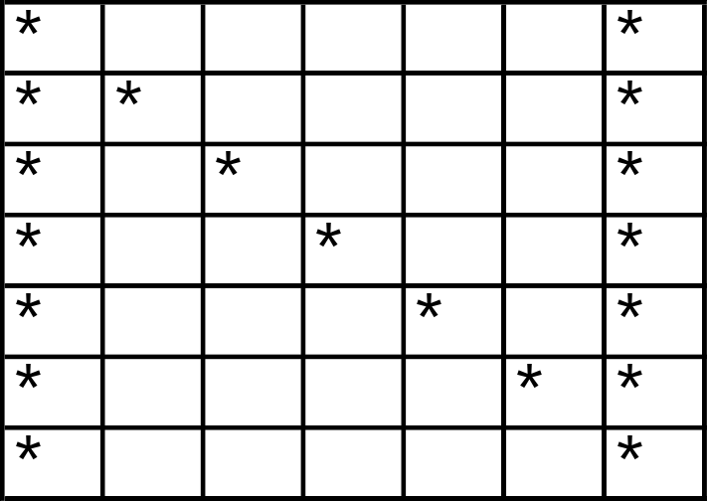
2D arrays
2D character array to create simple graphic of letters of alphabet.
E.g letter N looks as follows.
Put ‘*’ in certain locations to make letter.

Slide 13
1D array application
Convert a decimal number into binary.
Use an array bits[ ] to store the bits.
Algorithm. Convert to binary(number, bits[])
index = 0;
number = N; // choose N = 16 say
while (number > 0) {
bits[index] = number mod 2 // remainder when divided by 2
number = number / 2 // divide number by 2.
index = index + 1
}
print bits[i] in reverse order, from last to first. Need a for loop.

